Slide 1

VIDEOGRAPHY ON A BUDGET
DIY VIDEO PRODUCTION
Sarah Khan @sakhmeth sarah.khan@utoronto.ca

Slide 2
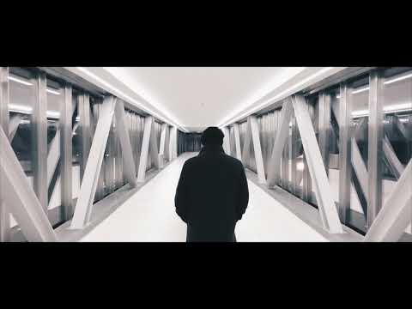

Slide 3
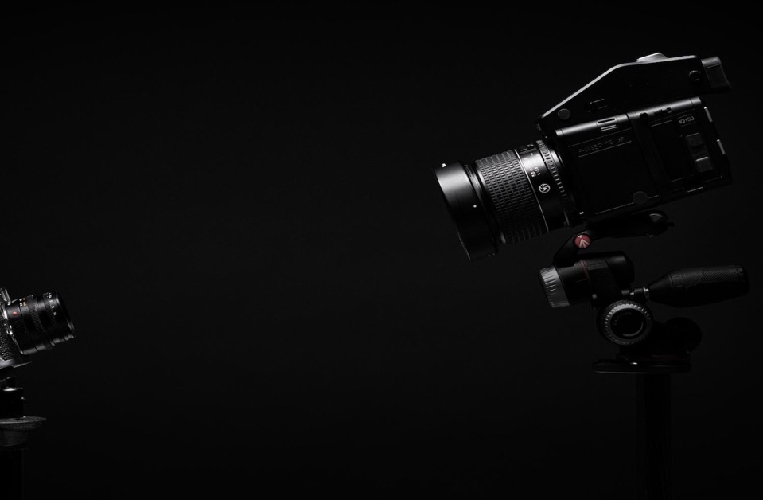
VIDEO IN 2018
Short and sweet
Easy to get point across
Mobile
Multi-Platform
Millenials visit YouTube daily
Time spent on video > social media
Fastest growing segment in content marketing
Notes:
YouTube - majority of millenials visit YT once a day or more
Millenials spend more time consuming video than on other social media
Growing segment in content marketing
Easy to get points across
Good for short attention spans
Consumed on variety of platforms
Short is better. <90 seconds = 53% retention. >30 mins = 10% retention.
Mobile

Slide 4
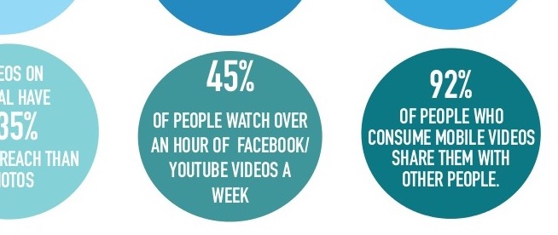
Notes:
Boston University Souce https://www.slideshare.net/EmilyTruax/reimagining-video-on-social-media

Slide 5
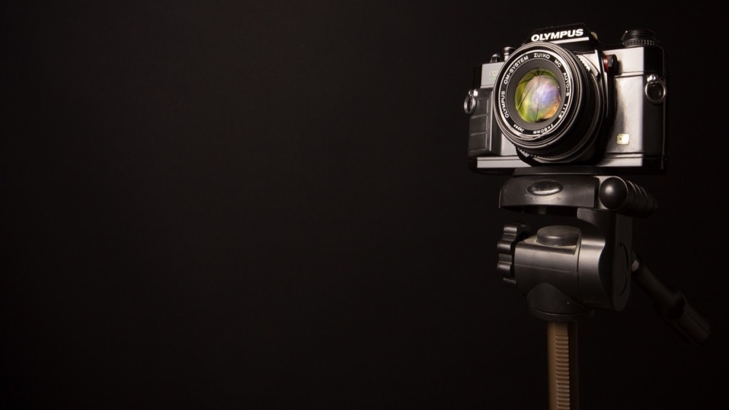
PREPARATION

Slide 6
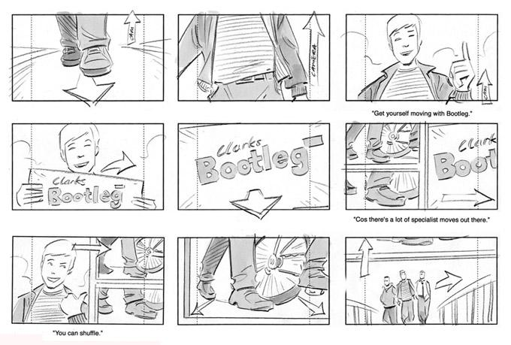
STORYBOARD
SCRIPT
SHOT LIST
Source: oneupweb

Slide 7
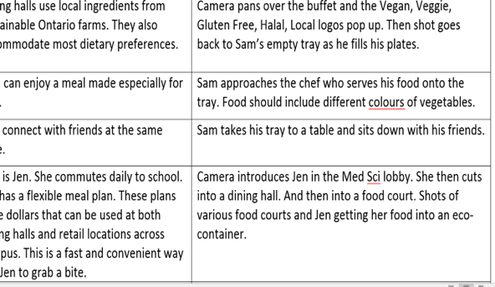
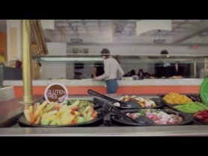

Slide 8
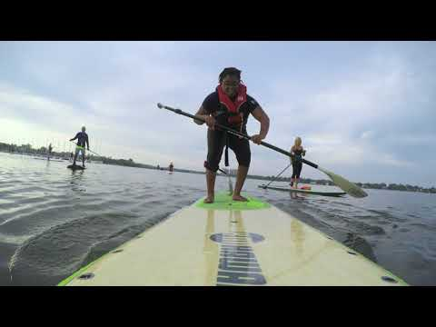
LOCATION
Use a variety of locations
Avoid offices
Avoid noisy spaces
Go on location when possible

Slide 9
HARDWARE

Slide 10
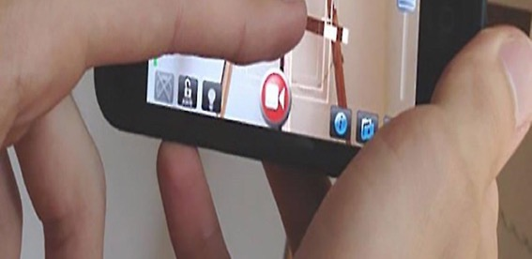
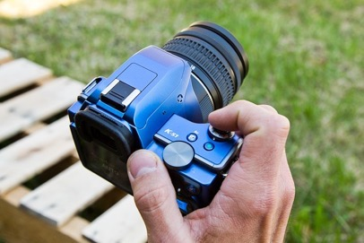
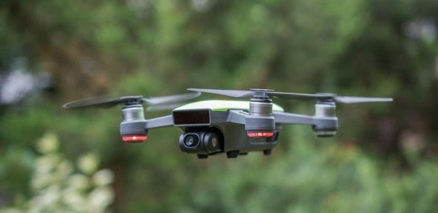
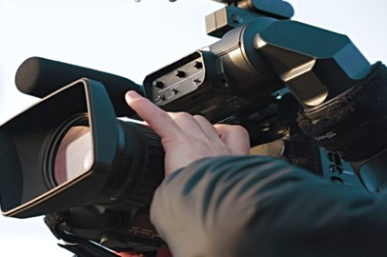
CAMERA

Slide 11

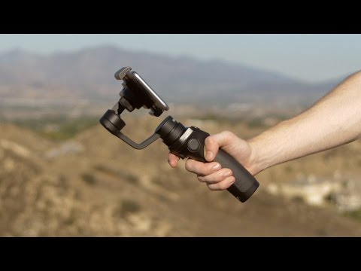
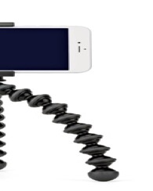
TRIPODS & GIMBALS

Slide 12




LIGHTING
Fill the shadows
Key and fill lights next to camera
Light behind the subject (back light)
Shade on a sunny day
Diffused light
Neutral white light
Notes:
Source: https://wistia.com/library/lighting-on-the-fly

Slide 13
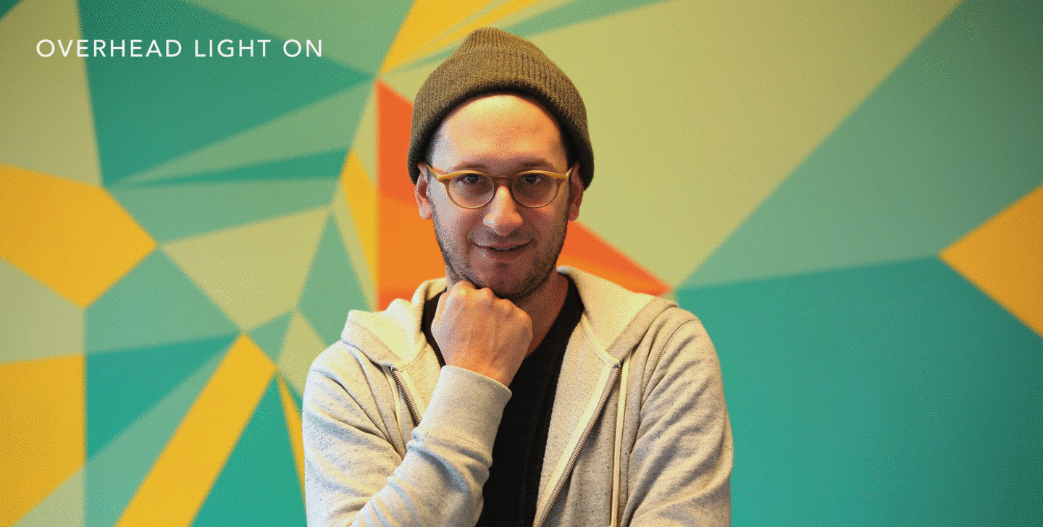
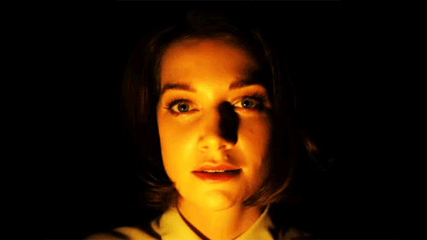

Slide 14
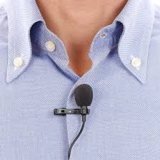
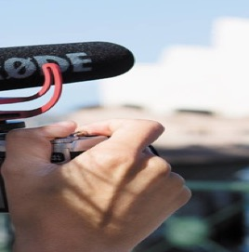
MICROPHONE
Lavelier/Lapel
Shotgun
Popular brands:
Rode
Apogee
Shure

Slide 15
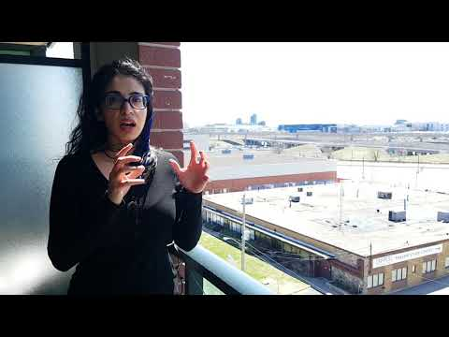
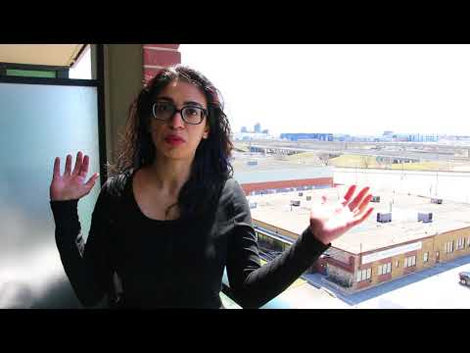
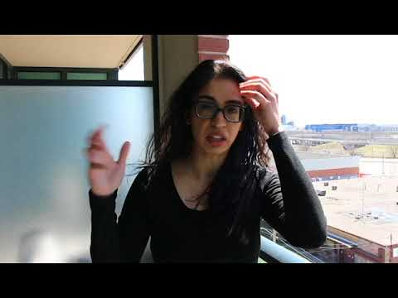
SOUND TESTS
Cell Phone Microphone
Camera Microphone
External Microphone

Slide 16
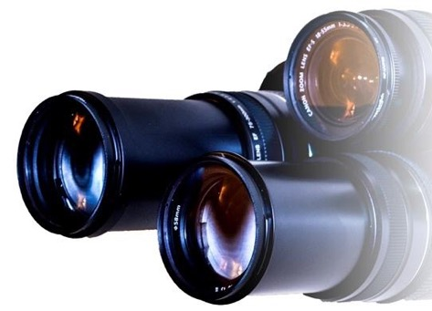
SOFTWARE

Slide 17
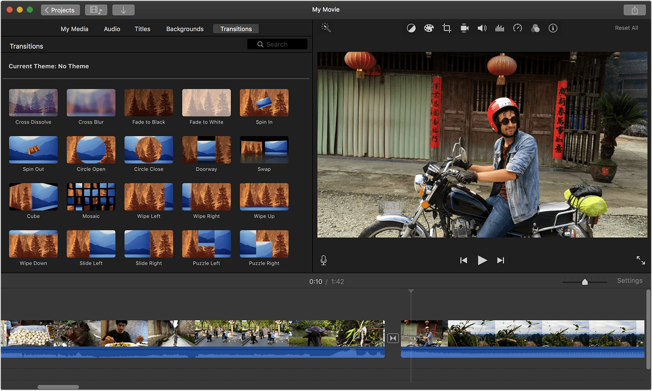
iMOVIE

Slide 18
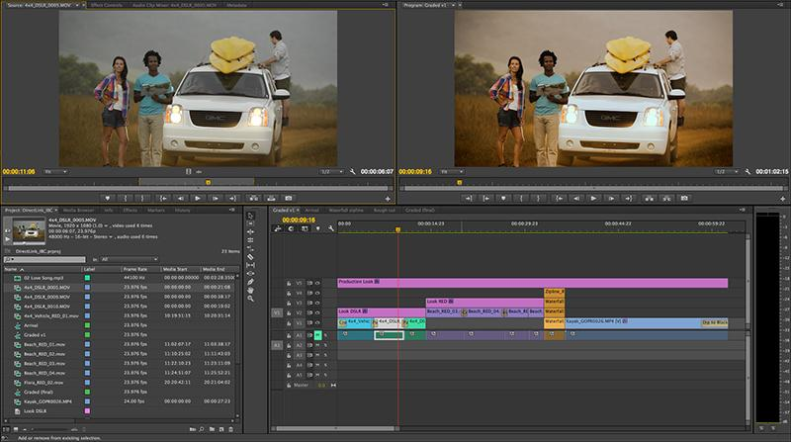
PREMIERE PRO

Slide 19
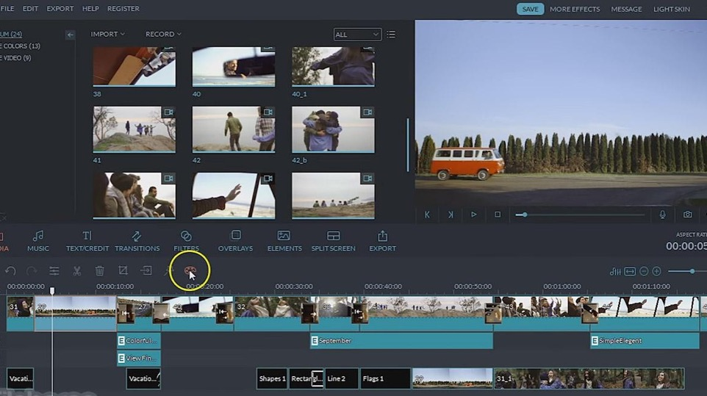
FILMORA

Slide 20
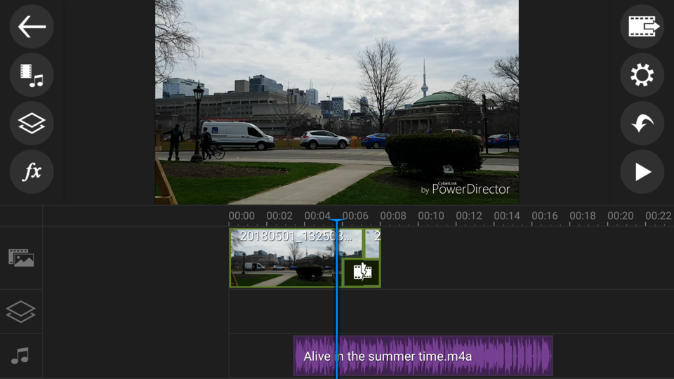
POWER DIRECTOR

Slide 21
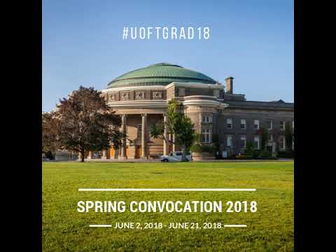
CANVA

Slide 22

ADOBE SPARK

Slide 23
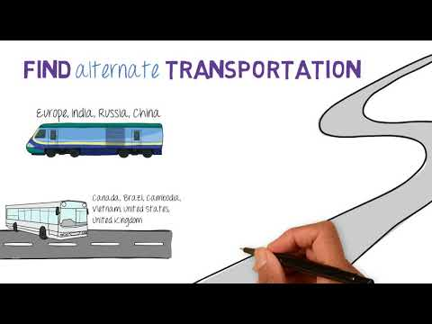
VIDEOSCRIBE
Adobe Animate
Pencil2D
Powtoon
Blender

Slide 24
TRICKS

Slide 25
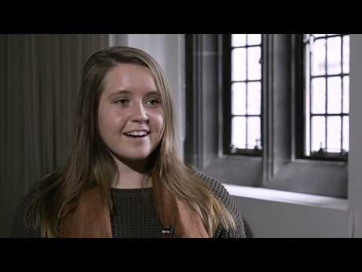
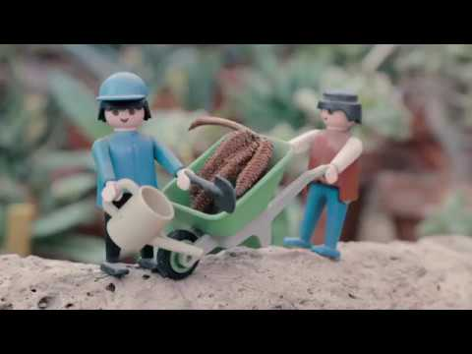
B-ROLL FOOTAGE

Slide 26
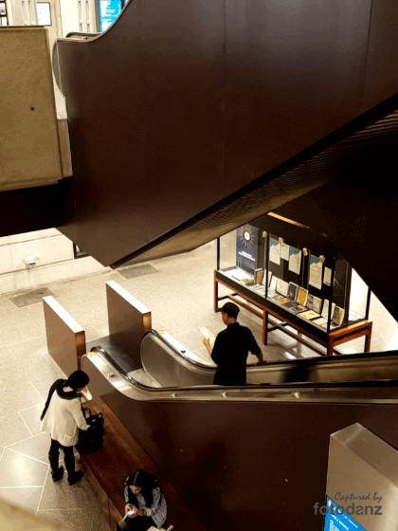
FREEZING MOTION

Slide 27
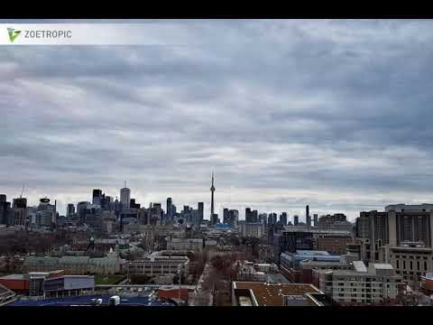
ANIMATING PHOTOS
Zeotropic
Plotaverse

Slide 28
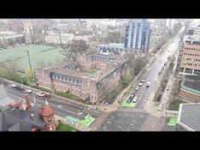
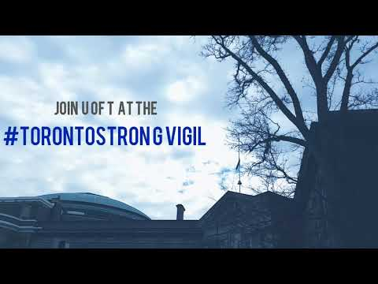
TIMELAPSE/HYPERLAPSE
Phone camera
Framelapse
LapseIt

Slide 29

STOP MOTION

Slide 30
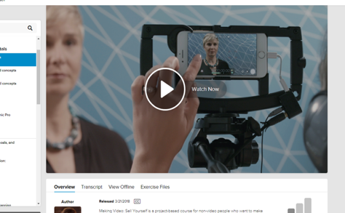
FINAL TIPS
Keep it short
Practise
Learn: Lynda, SCS, Ryerson
Less than 90 secs
53%
More than 30 mins
10%

Slide 31
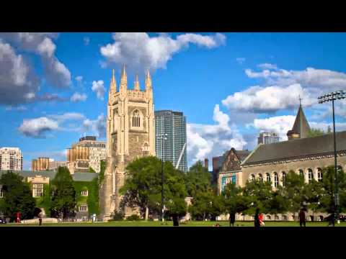
QUESTIONS?

